Slide 1
FATIGUE
Fluctuating Stresses

Slide 2
Fatigue Terminology
Stress
σ_{max,} σ_{min}
σ_{m,} σ_{a}
σ_{r}
CYCLE
STRESS
NUMBER OF CYCLES

Slide 3
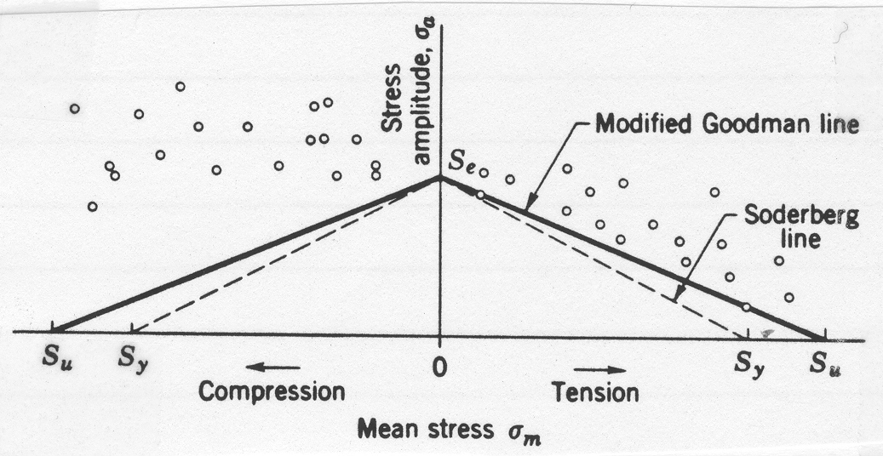
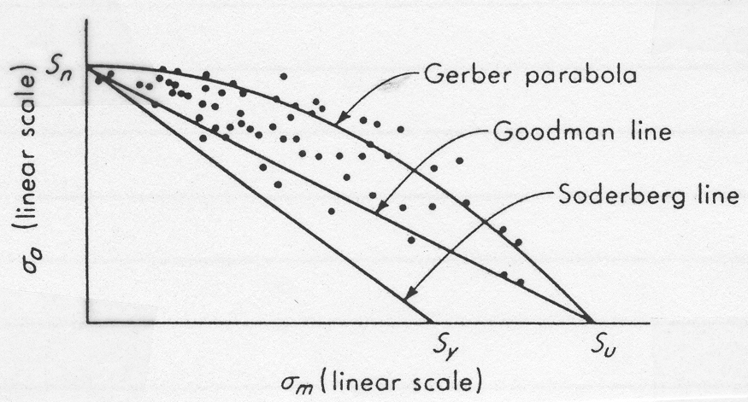
σ_{m}-σ_{a} Diagrams for Axial and Bending Loads

Slide 4
σ_{m}-σ_{a} Diagrams, A Closer Look Modified Goodman Diagram
σ_{a}
S_{y}
S_{e}
σ_{m}
S_{y}
0
S_{y}
S_{u}

Slide 5
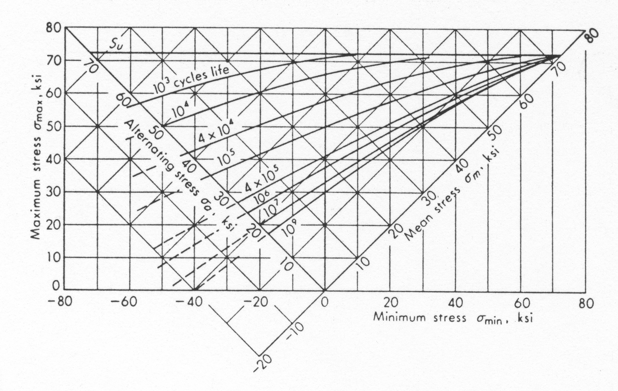
2024 Al

Slide 6
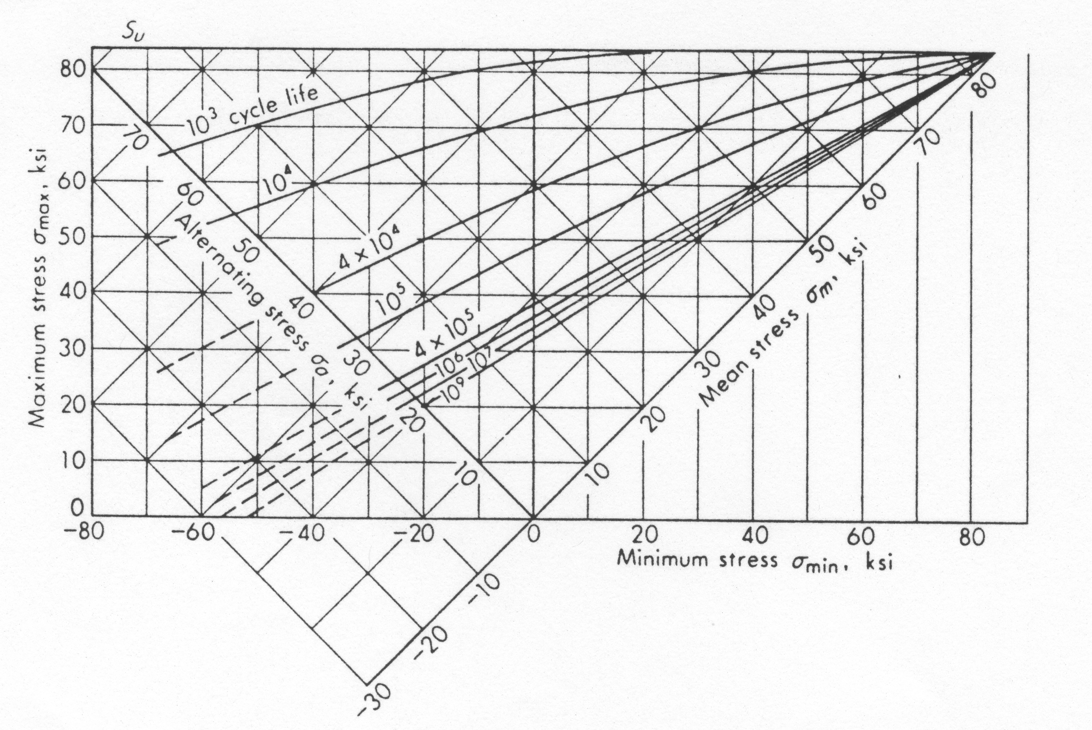
7075 Al

Slide 7
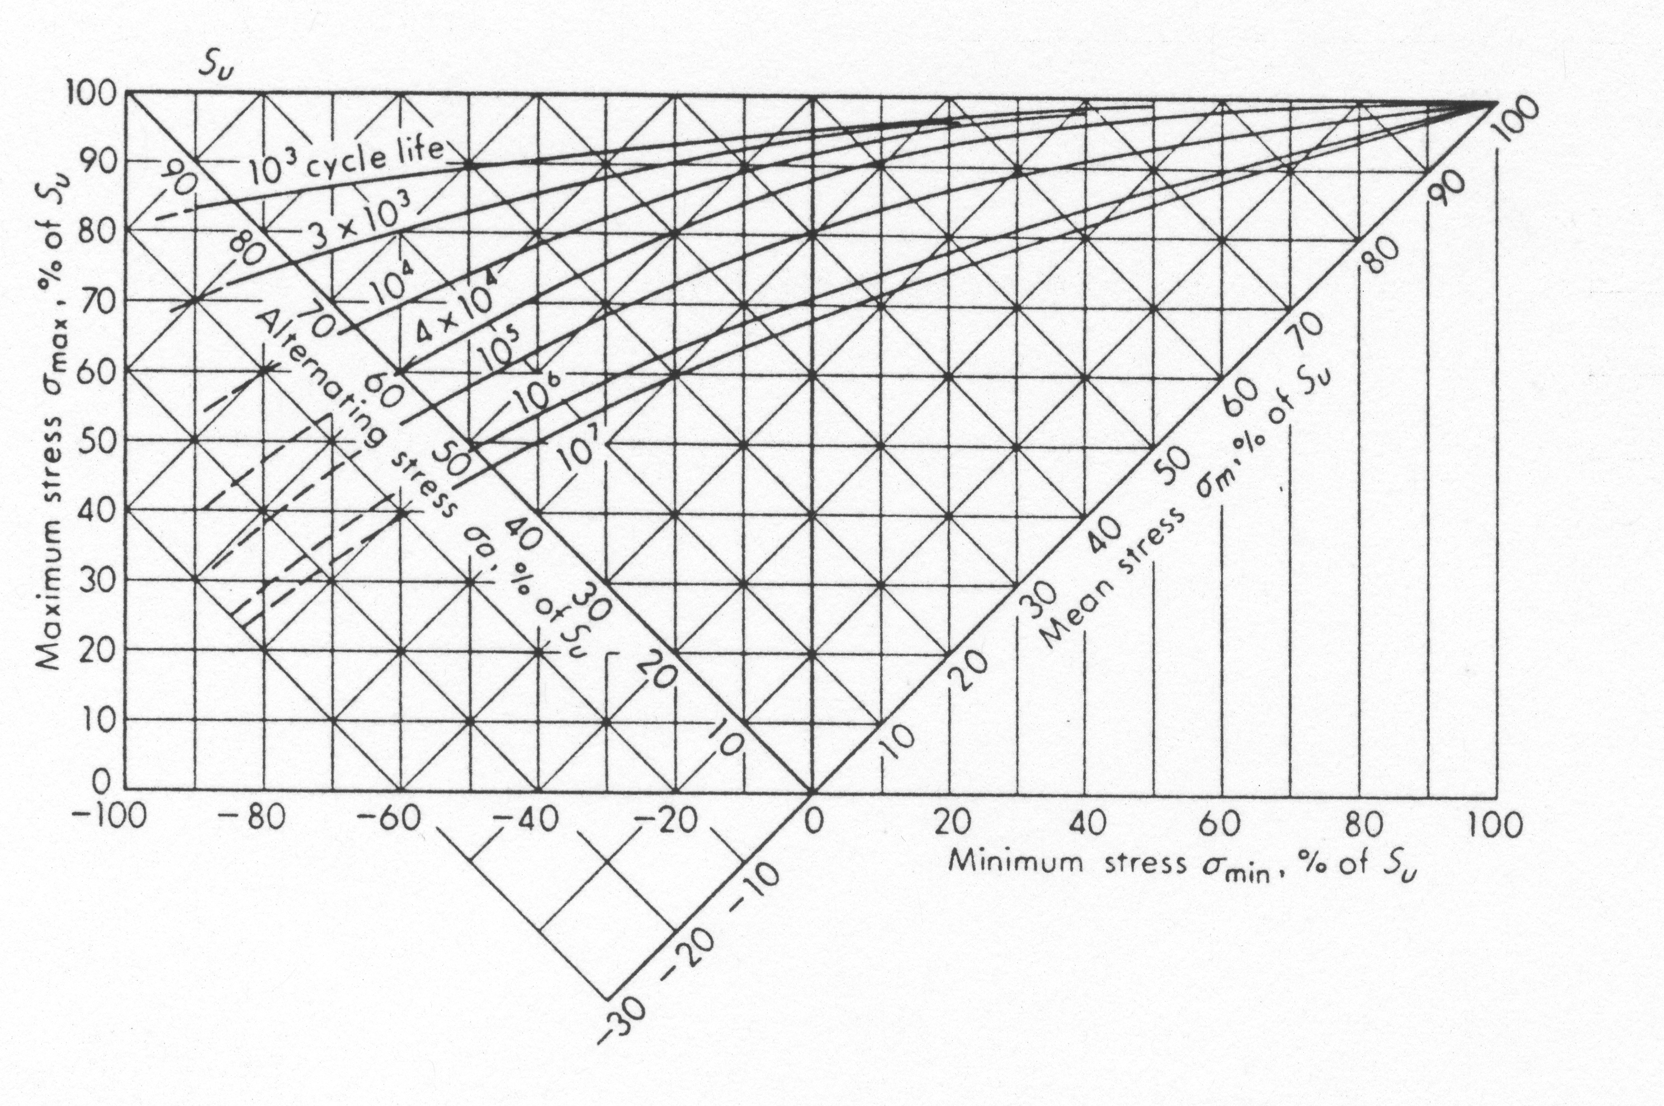
Steel

Slide 8
Example
1/8 in
A part made of 1/8in thick 7075-T6 aluminum alloy. It is subjected to a tensile load that fluctuates between 1000 and 5000lb. Determine its estimated life.
3 in
1 in

Slide 9
Example
It is desired to determine the size of a UNS G10500 cold drawn steel bar to withstand a tensile preload of 8kips and a fluctuating tensile load varying from 0 to 16kips. Owing to the design of the ends, the bar will have a geometric stress concentration factor of 2.02 corresponding to a fillet whose radius is 3/16in. Determine a suitable diameter for an infinite life and a factor of safety of at least 2.0.

Slide 10
Fatigue Failure Due to Combined Stresses
Distortional Energy Method
Mean von Mises Stresses
Alternating von Mises Stresses

Slide 11
Factor of Safety: Three Interpretations
N – Normal Point, Normal Operating Load
Q,P,R – Three interpretations of anticipated design overload points
σ’_{a}
S_{y}
σ_{a}
σ_{m}
S_{e}
Q
P
F
E
N
R
D
σ’_{m}
A
B
C
S_{y}
S_{u}

Slide 12
Example
A bar of steel has S_{u}=700MPa, S_{y}=500MPa, and a fully corrected endurance limit of S₃=200MPa. For each case below find the factor of safety which guards against static and fatigue failures.
1.
2.
3.
4.

